Slide 1
Draft Letter to EPA and IEPA to Perform Further Testing
Denise Trabbic-Pointer, CHMM Emeritus
Sierra Club - Michigan Chapter
Volunteer: Toxics and Remediation Specialist
With assistance from Sonya Lunder, Senior Toxics Advisor

Slide 2
Key Points to Make to IEPA to Support Further Testing
IEPA Points in Their Letter
Brownfield Engineering results show no exceedances of regulatory standards offsite
Off-site sampling did not indicate water quality violations related to the fire
IDPH issued health interpretive letters to residents where wipe samples collected
Air monitoring by USEPA did not detect any substances at levels of concern
IEPA cannot speak to 3rd party results from furnace filters
Our Counter Argument
Brownfield may be miss-using criteria that was developed for the M&H superfund site. Matthiessen Playground Mn levels are very near (only 40 Kg below) criteria.
Magnesium levels were slightly higher downriver from Carus. Metals would sink
The impacted residents report that they did not receive anything from IDPH
EPA data was not continuous, they used an OSHA standard for comparison. We do not think this is appropriate. See next slides.
The furnace filter results, 1) showed that additional metals were in the particulate from the fire and 2) the results from the 17 filters, in conjunction with the Library PM2.5, supports this premise and shows that Carus is a daily contributor to PM2.5

Slide 3
LaSalle Public Library Data
Recognition and thanks to them for providing the data

Slide 4
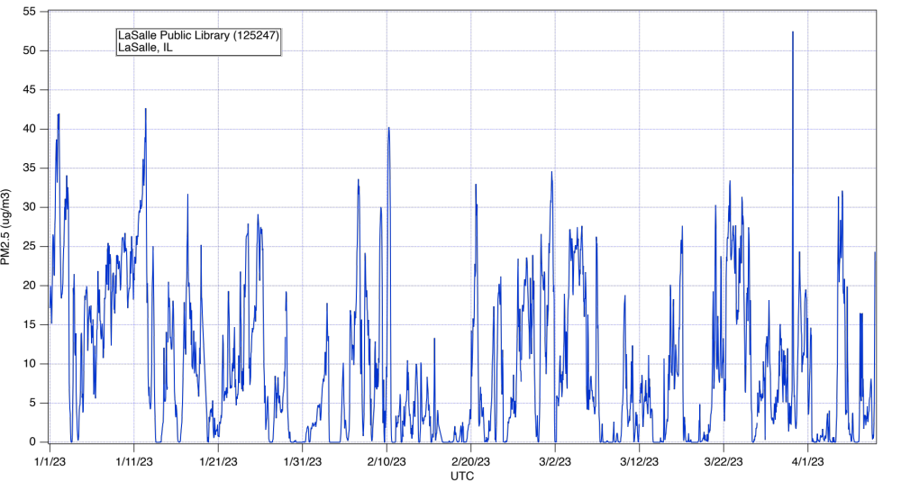

Slide 5
A closer look at PM2.5 emissions before, during the fire, and after.

Slide 6
The initial start-up of both products reportedly were partial shift and less than 5 days/week. The point being that they ramped up slowly.
Note that many data points went to zero and then there is a definite upward trend in emissions following the combined start-up of Phosphates and Catalyst.

Slide 7
Back to: Key Points to Make to IEPA to Support Further Testing
IEPA Points in Letter
IEPA does not believe that further testing is warranted, including for indoor air quality. It would be difficult to attribute the results of indoor air pollution to a specific cause
Our Counter argument
The community has general concerns about the lack of consideration to cumulative health impacts to vulnerable populations and risks to children. Besides comparing each result to some criteria, cumulative impacts are something that needs to be considered by the responsible parties.
Residual dust in home furnace system ductwork will continue to cycle through home heating and cooling systems and will settle on surfaces in the home, including where children play.
Studies indicate that inhalation of Mn is of concern, especially for children. Chronic over exposure can lead to impairment and deficits in neurodevelopment and intellectual functions.

Slide 8
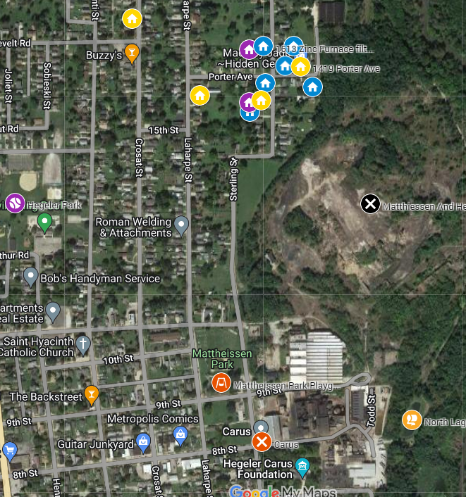
Not all homes where filters were collected are shown but the primary point here is to spatially show where the most highly impacted homes are (highlights in yellow) and to illustrate that there is a lack of information for homes south and west of Carus.
Map Link

Slide 9
Key Points to Make to IEPA to Support Further Testing
Recommended Further Sampling and Actions
Additional surface soil and furnace filter samples south and west of Carus
Further delineation of levels of Mn in soil in Matthiessen Park and playground. Clean-up if required
Surface wipe sampling for Mn inside homes is recommended and will provide additional information about ongoing inhalation hazards inside people’s homes. Performing some testing in homes where furnace filters and/or soil has already been completed is recommended. At least two background homes are recommended.
Up- and downstream sediments should be tested for relevant metals in the Little Vermillion near the Carus site outfall
We recommend working with the LaSalle Public Library to pull monthly data as Carus continues to ramp up production. I am happy to compile, share, and analyze the data.
Mila and I have at least 2 contractors to recommend that can do the work if decided. I can put together a scope of work (SOW)
I bring up the impending Carus air permit renewal again and suggest you watch for any opportunity for public comments. Because of what we see in the Library data, we recommend that Carus be required to add fenceline monitors. This can be separate from or part of their new air permit.

Slide 10
Questions dtrabbicpointer@gmail.com

